Slide 1

ACCOUNTING SOFTWARE

Slide 2
Life made easy with Accounting Software
Accounting Software is designed to compute account related information in a user friendly manner to compute and analyze data faster. Most software’s are designed not only to collect and analyze data but also used for functioning of business. To record and process accounting transactions within functional modules such as accounts payable/ receivable, payroll and trial balance - we employ an Accounting Software .

Slide 3
It functions as an Accounting Information System. At first glance all accounting software look similar but beyond these core attributes lie dozens of other features covering a vast array of functions and services. Some of these features can be considered indispensable. Many others however, are marginally useful or nothing more than marketing gimmicks.

Slide 4
Reporting and Analysis
- Besides helping users gain insight into crucial financial activities, reporting and analysis functions help companies conform to government and industry regulations.

Slide 5
Graphics
- Accounting is a numbers-focused activity. Yet graphics , in the form of charts and other illustrative formats, is a powerful tool that can be used to present trends and other concepts in a way that numbers alone can’t convey.

Slide 6
Automation
- For many business concerns support for simple accounting transactions and basic financial management tasks just isn’t enough. Many companies require the full amount of employee expenses, payrolls and time sheets, company and departmental budgets, purchase requisitions and other complex financial activities.

Slide 7
Automatic Updates
- Using out-of-date accounting software is like eating food that has passed its date of expiry. Tax laws, regulations and financial practices change over time, so it is vital to use software that receives fast, user-transparent and automatic updates

Slide 8
Customization
- Chances are that no accounting software will exactly match your business needs. That is why the software should allow easy customization of statements, forms, reports, screens, help systems and other program facets.

Slide 9
Interoperability
- Data entered can be productively used by various business applications in HR, sales, shipping other key business sectors. Conversely, you may want your accounting program to draw information from other sources.

Slide 10
Internet Connectivity
- With the world on the web accounting software should enable transmission and reception of digital documents and handle electronic fund transfers.

Slide 11
Scalability
- When business expands the software should keep pace through up gradation to accommodate a large number of users and a growing amount of financial data and transactions .

Slide 12
Expandability
- The business can grow both in size and scope. The accounting software should either offer add-on modules that allow customers to slap extra capabilities to its product or migrate to a full ERP environment .

Slide 13
Security
- The entire business depends on the accounting software for its existence. If data is lost or tampered with, you stand to lose time, money, business secrets (such as sales or profit data) and, if damage is severe enough, the company itself. We should be aware of the software’s built-in security features as well as how its product’s ability to mesh with on-site safeguards (such as anti-malware technology and network firewalls).

Slide 14
If you are looking for an easy and fast software to manage your business, myAbakus can help you:
✓ Send sales invoices and manage customer info
✓ Track expenses, bills to pay, and cash accounts
✓ Manage inventory, cash flow and more! No accountant or accounting knowledge required, so we recommend that the accountant sticks to its own: Taxes

Slide 15
What is myAbakus?
myAbakus is an easy to use and simple bookkeeping software designed to help those who view accounting more as a management tool than a fiscal obligation and want reliable and up-to-date financial information, with the daily management and control of their businesses.

Slide 16
Who can use myAbakus?
Any person, group or entity interested in keeping its accounts in order and up-to-date: entrepreneurs, small businesses, freelancers, non-profits. Users of our simple bookkeeping software around the world are in professional services, retail, manufacturing, or simply want to keep track of personal expenses.

Slide 17
Why use myAbakus?
We recommend you use our simple bookkeeping software because understanding and controlling your business finances is important for its survival and growth. And because given the personal effort required, you should know for sure if your business is generating (or not) an adequate profit.

Slide 18
Can I try before paying?
Sure. Our simple bookkeeping software comes with a 15-day free trial period that can be extended up to 45 days for those who remain active entering data. And during this time you can add as many features as you want to your plan, so that you can test them adequately before buying a subscription.

Slide 19

Easy online invoicing and customer management system
Create and customize your invoices with your company's logo, print them, or email them directly to your customers.

Slide 20
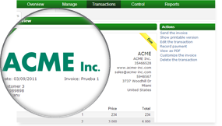
Easy and online invoicing
Customize your invoices with your own logo and comments, then you can print them or send them directly by e-mail. We offer the possibility of using pre-printed forms as an additional service.

Slide 21
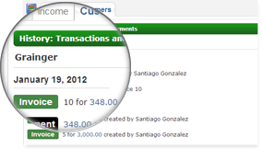
Customer management (CRM)
Keep all customer information in the customer management system, where you have access to detailed income and accounts receivables reports. It's the ideal way to see which are your best customers or identify which ones need special follow-up in order to retain them as customers.

Slide 22
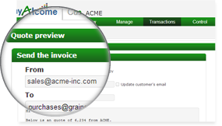
Send quotes by e-mail
Ever needed to send a quick quote to close a deal? In myAbakus you can create quotes with existing product and customer information, and then you can send them directly by e-mail. Quickly convert quotes to invoices in order to speed up your billing process.

Slide 23
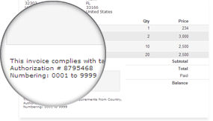
Custom, tax friendly invoices
In myAbakus you can customize your invoices with your own header and footer, adding any text or legal wording required by your local tax authority for use on legal invoicing documents.

Slide 24

Accounts receivable management
Keep your sales and collection data up to date to make sure customers are paying you when and how they should.

Slide 25
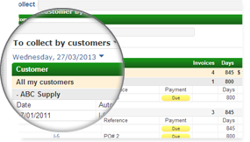
Spot aging receivables problems
On a single accounts receivable aging report, check which customers are behind on their payments, for how long, and for what amount. This is very important to avoid cash shortages!

Slide 26
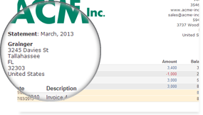
Send statements by e-mail
To increase accounts receivable turnover ratio, send your customers quick reminders of how much they owe you. In myAbakus, you can send account statements by e-mail, which show a clear history of invoices, payments and amounts due.

Slide 27
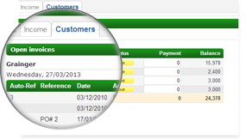
Register multiple payments
When a customer owes several invoices, they often send bulk payments with one check or transfer to cover various invoices. In myAbakus you can enter this type of payments, keeping one cash entry to allow for easier bank reconciliation.

Slide 28
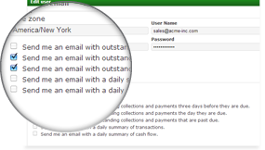
Important alerts to your e-mail
Setup important alerts to be sent to your e-mail when invoices are past due so you can take action and send statements and reminders to your customers.

Slide 29

Cash control and bank reconciliation
Make sure everything (that should) has been accounted by keeping your cash accounts up to date and reconciled.

Slide 30
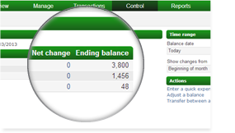
Unify management of all cash, credit, and bank accounts
In myAbakus you can keep track of all your cash on hand, credit cards, loans and bank accounts. You can also make adjustments and transferences between each other.

Slide 31
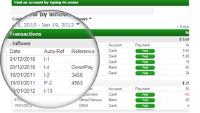
Bank reconciliation
With the cash flow report you can easily reconcile each account to make sure they reflect all transactions and real balances shown on the bank statements and petty cash receipts.

Slide 32
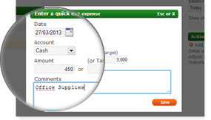
Enter all pending and recurring expenses
In myAbakus you can control your cash by entering all pending payments and recurring expenses, in order to feed the cash flow report and plan your future cash positions.

Slide 33
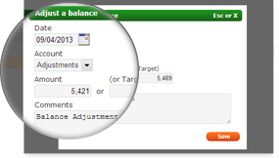
Make adjustments and transfers
Easily adjust balances, make capital contributions and transfer between accounts. Keep all cash accounts updated in order to know your real financial position and obligations.

Slide 34

Cash flow management for financial decisions
Stay ahead of the game and avoid nasty surprises by entering pending collections and payments, as well as recurring expenses.

Slide 35
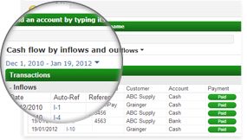
Know your real cash flow position
With the cash flow report you will be able to determine how your financial position will be on the future and you will be able to make good decisions regarding loans, expenses and investments.

Slide 36
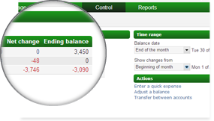
Anticipate financing needs
Use the cash flow report to foresee situations where you may need additional financing and determine whether you can make use of income from accounts receivable or if you will have to go to the bank for a loan .

Slide 37
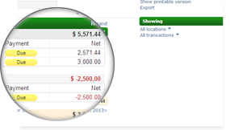
Foresee cash shortages and plan ahead
If you keep track of future expenses and pending payments from customers you can easily forecast cash shortages.

Slide 38
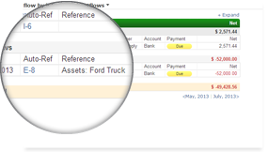
Plan your investments wisely
Use the cash flow report to plan the use of available resources for investments, stock replenishment or purchase of fixed assets.

Slide 39

Inventory management and fixed assets register
Maintain system and real quantities synced, know when to reorder, and see how your products are contributing (or not) to your bottom line.

Slide 40
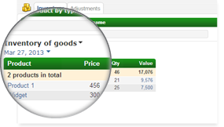
Control your product list
In myAbakus you can enter and manage a list of products that reflect your business operation. You can enter code, price, cost and reorder amount for each one.

Slide 41
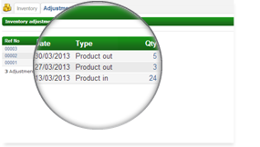
Adjust and transfer quantities
Update the stock amount on myAbakus with the one from a physical verification of stock. If your company has more than one warehouse or store, you can adjust or transfer amounts from one to another.

Slide 42
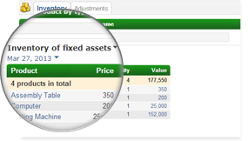
Manage materials and fixed assets
Manage the units and cost of your fixed assets. If you manufacture or assemble, in myAbakus you can keep track of parts, materials, and cost of goods sold.

Slide 43
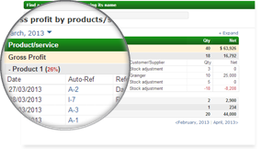
Optimize inventory rotation and product gross profit
Inventory reports are designed to provide you with insights on which you can take actions, such as verifying optimal rotation quantities and determining real gross profit per product.

Slide 44

Business financial management
Once you understand and measure your business's performance, you can set goals, take actions, and evaluate results.

Slide 45
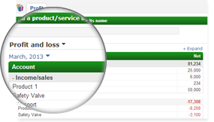
Stay on top of your profit
With the Profit report (P&L) you can analyze your operation's performance and make decisions regarding sales strategies or cost reduction schemes.

Slide 46
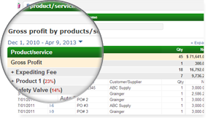
Real product profitability
Use the profit report to make decisions regarding your product lines, such as finding new vendors, and optimizing your production processes.

Slide 47
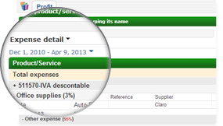
Stay on top of expenses to avoid loss of profit
Use the expense detail report to identify expense categories that are draining funds from the company and affecting your profit.

Slide 48
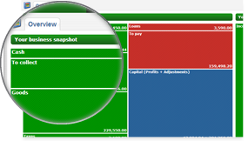
See your financial position in a snapshot
Every time you enter myAbakus you can see a quick snapshot of your current financial position, and also the sales and profits for the current month.

Slide 49
However, human frailties of miscalculations and forgetfulness can have disastrous consequences on Accounting. So the question of implementation of software is of utmost importance. Basic training in the use of software may be necessary and only when thorough knowledge is gained with all the aspects of the accounting software, should it be installed and configured in our system.

Slide 50
.... .. ... is the degree to which something is simple and easy to use.
…………. is the degree to which something is practical and useful.
A …. ……. Is the official legal permission to use a computer program.
…. …… is the analysis of information to find patterns within it.
…… …… is the ability to use a program from a computer or electronic device other than the one that the program is installed on.

Slide 51
KEY
EASE OF USE
FUNCTIONALITY
USER LICENCES
DATA MINING
REMOTE ACCESS

Slide 52
THANK YOU FOR ATTENTION

